Slide 1
Simple Action Game
Design and implementation

Slide 2

CONTENTS
01
Locomotion
02
Attack Check
03
Block Logic
04
Combo Logic

Slide 3
CONTENTS
05
Execution
06
Boss AI

Slide 4
01
Locomotion

Slide 5

Primary function
Manage character basic state
Controll basic move
Locomotion

Slide 6
Locomotion
Import locomotion data:
DesiredGait：定义玩家当前的步态
DesiredPoise：定义玩家当前的姿态
CharacterState：定义玩家当前的地面状态
CharacterMode：定义玩家当前的模式
CharacterAction：定义玩家当前进行的动作
ActionStage：定义玩家当前出于动作的阶段
Import interface:
BPI_ChangeCharacterAction
BPI_ChangeActionStage
BPI_GetCharacterAction
1

Slide 7
Locomotion
Rootmotion In Animation blueprint
Direction change
Stance change

Slide 8
02
Attack check

Slide 9

Attack check
use line trance implementation attck check

Slide 10
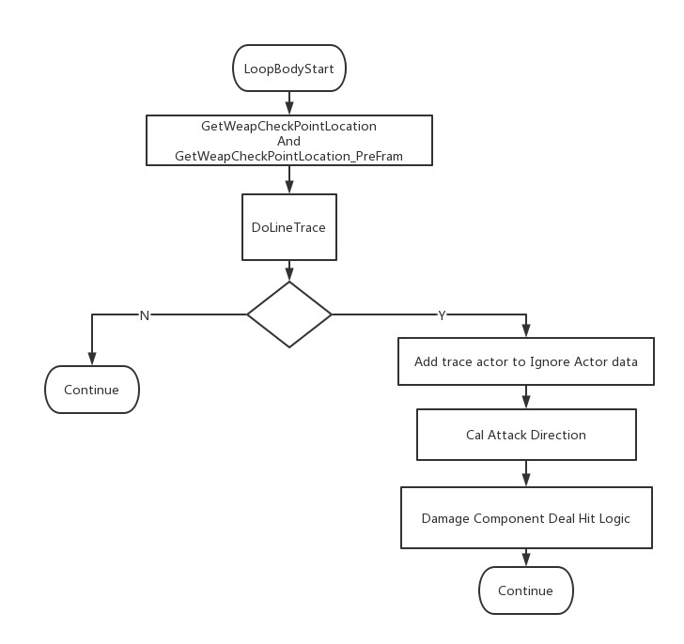
Implementation

Slide 11

Detect according to path
Custom detection size
Calculate the direction of attack
Advantage

Slide 12
03
Block

Slide 13
Judge perfect block
Successive block
Animation of attack direction
Attack impaction
Block

Slide 14
Data and Interface
Data
CharacterAction:
PerfectBlock
Block
Blocking
Parry
Broken
DefenseDirection:防御用手的方向
IsBlock:防御的按键状态
Interface
BPI_ParryEnd:格挡或者弹开动画结束后用于重置防御状态
BPI_ChangeDefenseDirection:改变防御用手的方向
BPI_BeatBack:处理击退的逻辑

Slide 15
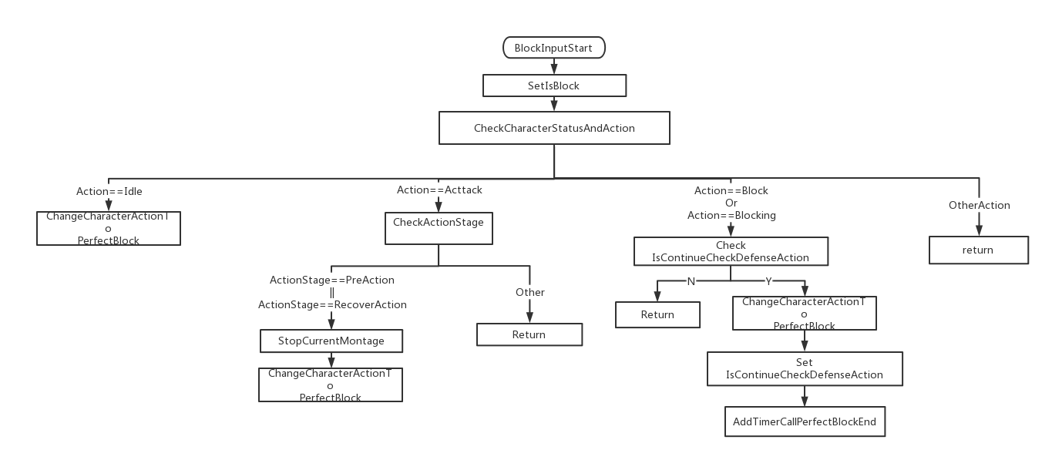
Block Input Flow Chart

Slide 16
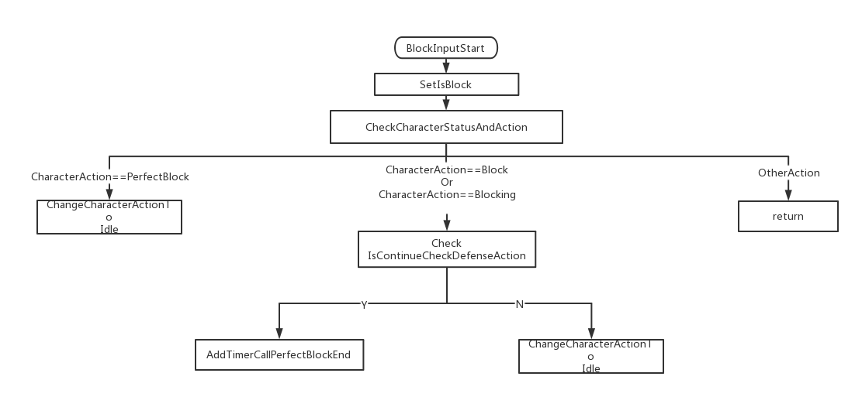
Block Input Flow Chart

Slide 17
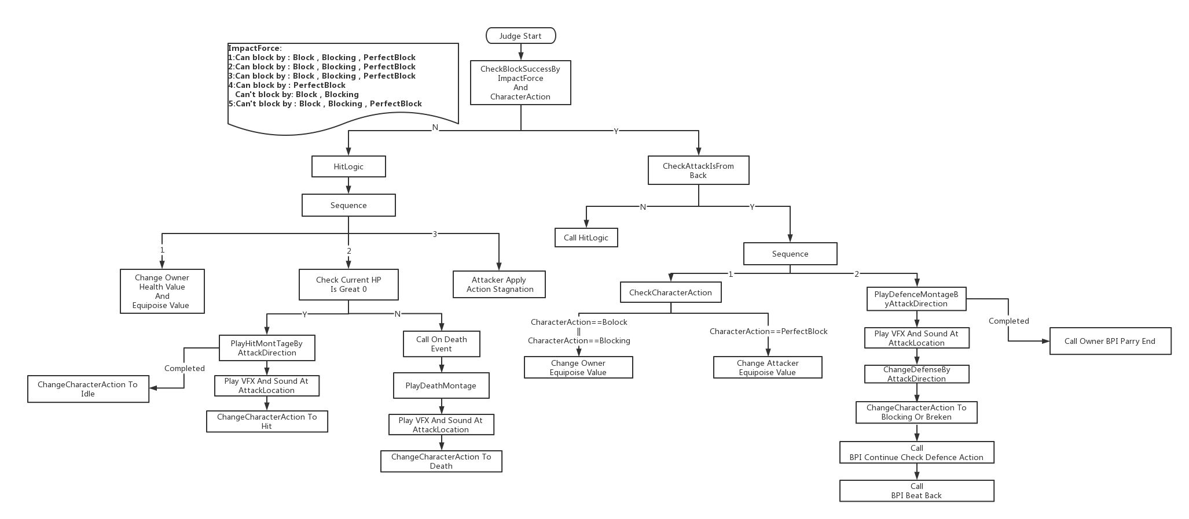
Block Judge Flow Chart

Slide 18
04
Combo Logic

Slide 19
Custom Define Combo Sequence By DataTabel
Map Direction To ComboInput
Simple Implement Input Cache
Simple Implement Charge Attack

Slide 20

Data and Interface
Data:
IsInCombo:是否处于Combo中
CanGoToNextCombo:是否可以进入下一段Combo
CacheComInput:缓存的输入Input
IsCacheComboInput:是否缓存Input数据
CanAdjustAttackDirection:是否允许在攻击中调整方向
CurrentCoboData:当前Combo的数据
InterFace:
BPI_ComboStart
BPI_ComboEnableAttackCheck
BPI_ComboResetAttackCheck
BPI_ComboDisableAttackCheck
BPI_ComboCacheInput
BPI_ComboEnableNextCombo
BPI_ComboDisableNextCombo
BPI_ComboEnd
BPI_GetComboData
BPI_ChangeActionStage
Combo Logic

Slide 21
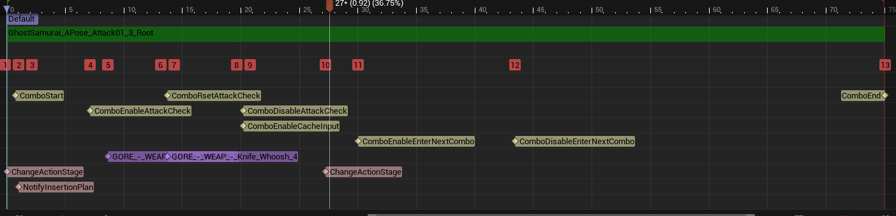
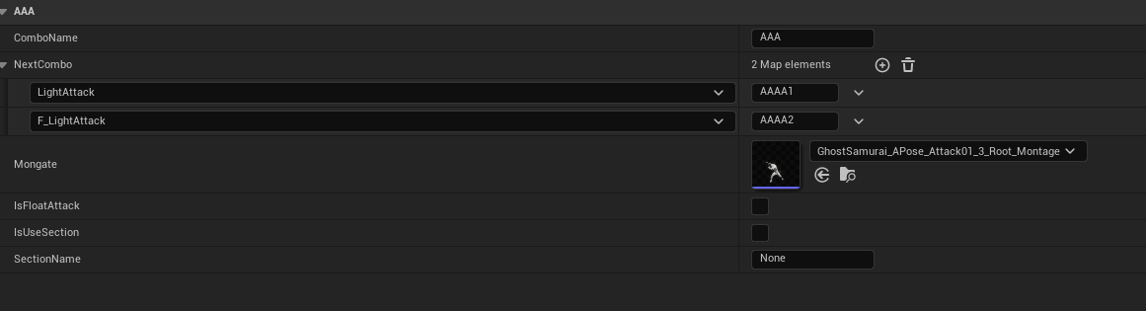
Montage Anim Notify
ComboData In DataTable

Slide 22
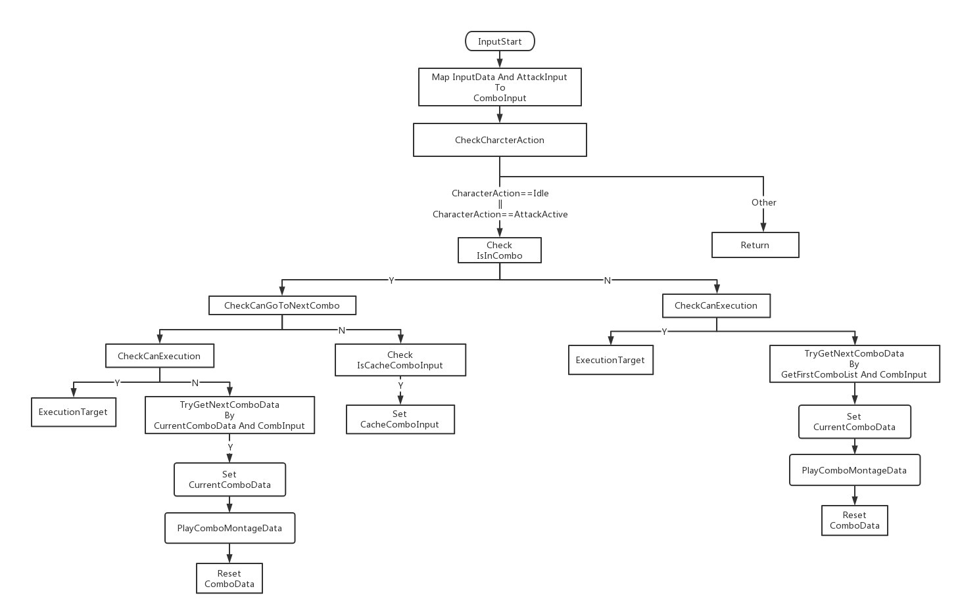
Combo Input Flow Chart

Slide 23
05
Execution

Slide 24
Use level sequence implement execution
Tod:Smooth transition to the animation playback position
Execution

Slide 25
Execution
Interface:
BPI_GetCanExecution BPI_PreExecutioned
BPI_PreExecution

Slide 26
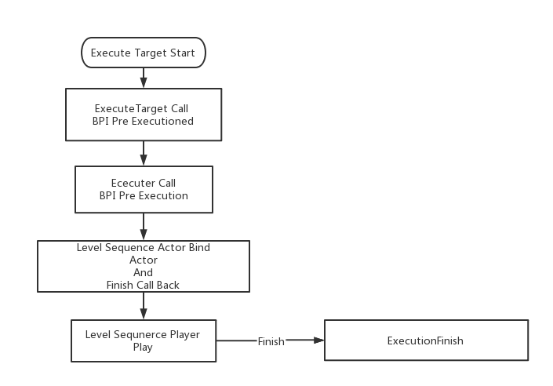
Execution Flow Chart

Slide 27
06
BOSS AI

Slide 28
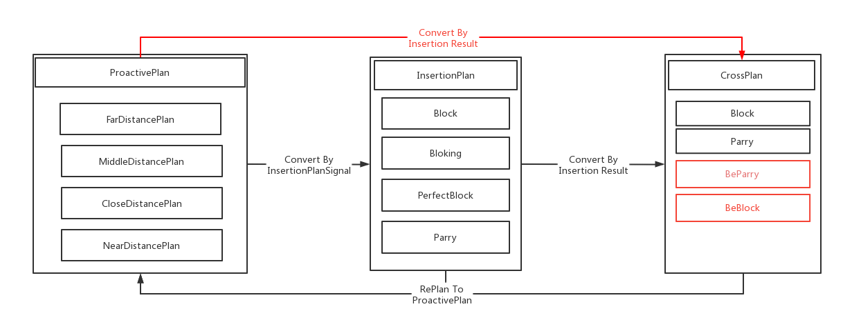
Basic AI Mode:
ProativePlan
InsertionPlan
CrossPlan
BOSS AI
References: https://www.bilibili.com/video/BV1264y197jc

Slide 29
THANK YOU！

